Slide 1
PRESENTATION OF BY-LAWS PROPOSED FOR TOWN MEETING CONSIDERATION
PLANNING BOARD PUBLIC HEARING
AUGUST 14, 2023

Slide 2
ARTICLES 14, 15, AND 16
CLARIFY |  | REORGANIZE |  | SIMPLIFY |  | PRESERVE
Clarify Land Use Permits |  | Make the By-laws better organized, more understandable and easier to follow |  | Move appropriate sections into Rules and Regulations |  | Leave sections on ZBA intact

Slide 3
SPECIAL PERMIT

Slide 4
SITE PLAN REVIEW

Slide 5
SITE PLAN REVIEW SPECIAL PERMIT

Slide 6
RECOGNIZE AS DIFFERENT LAND USE PERMITS
No review until application is complete.
Better definition of performance guarantees
Expand considerations to include sustainability
Develop Rules and Regulations to add detail and provide flexibility
6

Slide 7
ARTICLE 3 – USE TABLE
7

Slide 8
INTEGRATION OF THE CHANGES = MORE COMPREHENSIBLE ZONING BY-LAW

Slide 9
REVISION TO SOLAR BY-LAW
Whether to require notice of change of ownership and assumption of obligations under the SPR/SP
Whether to require a signed IA
Any other thoughts you may have

Slide 10
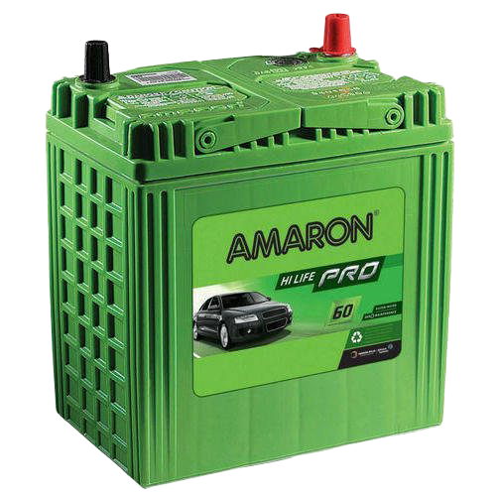
BATTERY STORAGE
Major Planning Board focus given numerous proposed facilities
Concerns:
Thermal Runaway
Fire Events
Air Quality
This Photo by Unknown Author is licensed under CC BY-NC

Slide 11
After three fires and a solar plant toxic fumes scare, New York launches safety probe into battery energy storage | Recharge (rechargenews.com)

Slide 12
POTENTIAL ADDITIONS:
Containment – but would need to be huge.
Requirement of water at site
Proactive monitoring system
Automatically update with changes in State law and standards

Slide 13
Questions and Comments?

