Slide 1
Decas Community Center Survey
Analysis of Results
Decas School Steering Committee
Completed 8/24/2022

Slide 2
Background
Survey was designed to answer a few questions:
  Do you support the community center proposal?
  Do you understand how it will be funded?
  What services or activities would you use at the community center?
  What social needs could be met by having a community center?
The survey ran June and July and was accessible via the Decas Steering Committee town webpage
354 answers were received (2 via paper responses at Decas Foundation events)

Slide 3
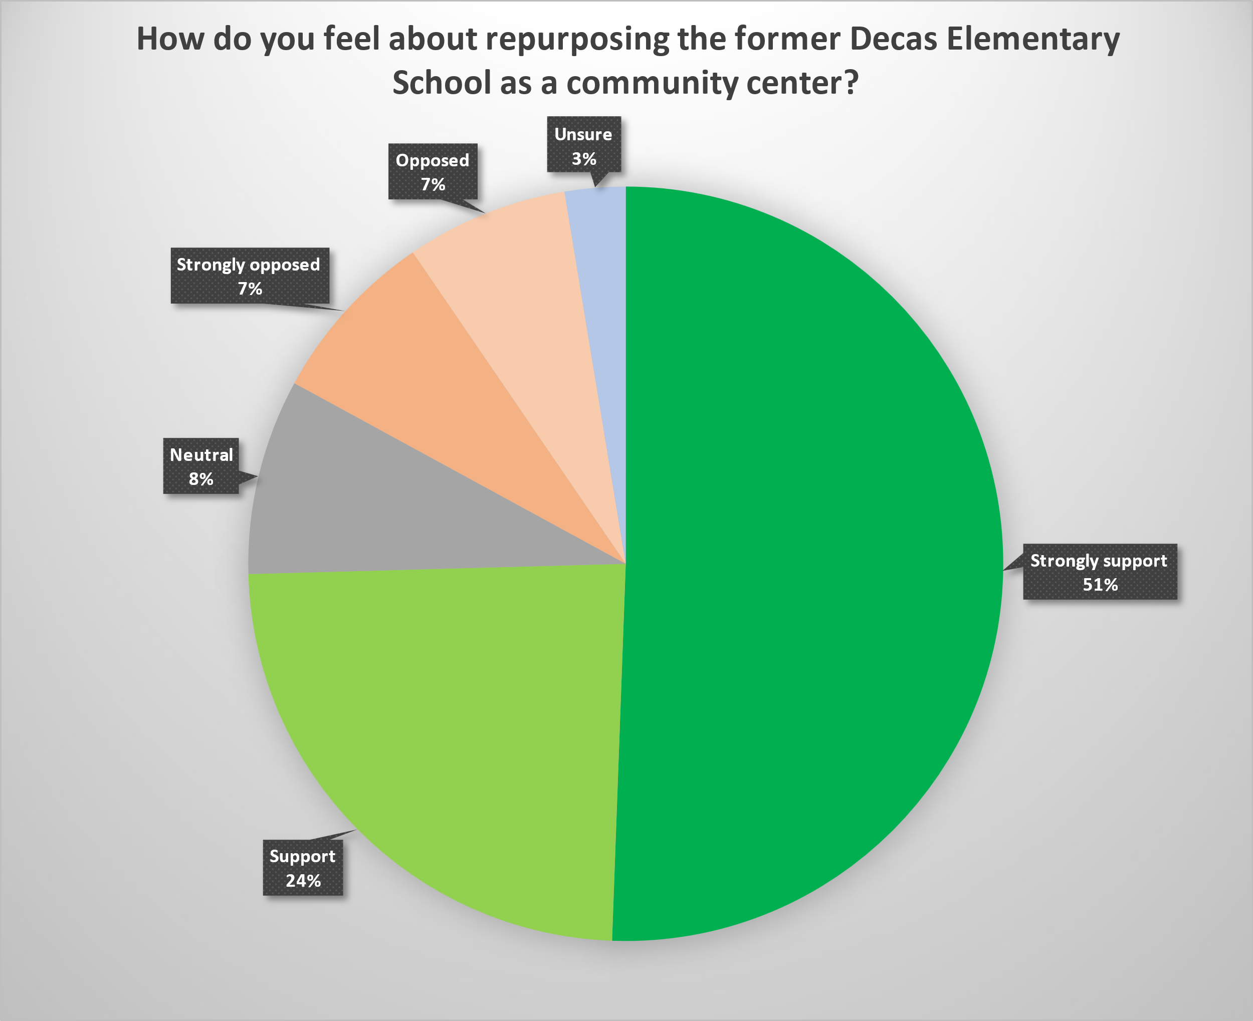
Do you Support the Proposal
75% of respondents support or strongly support the community center proposal
14% of respondents oppose or strongly oppose proposal

Slide 4
Distribution of Support By Sex
Women responded the most to the survey
Women were the most supportive of the Community Center proposal

Slide 5
Distribution of support By Age Ranges
People aged 65+ responded the most to the survey
People aged 65+ were also the most supportive of the Community Center proposal

Slide 6
Services And Activities
Most Popular Overall:
  Adult education
  CoA Portfolio
  Grounds
  Social Events
  Cooking Classes

Slide 7
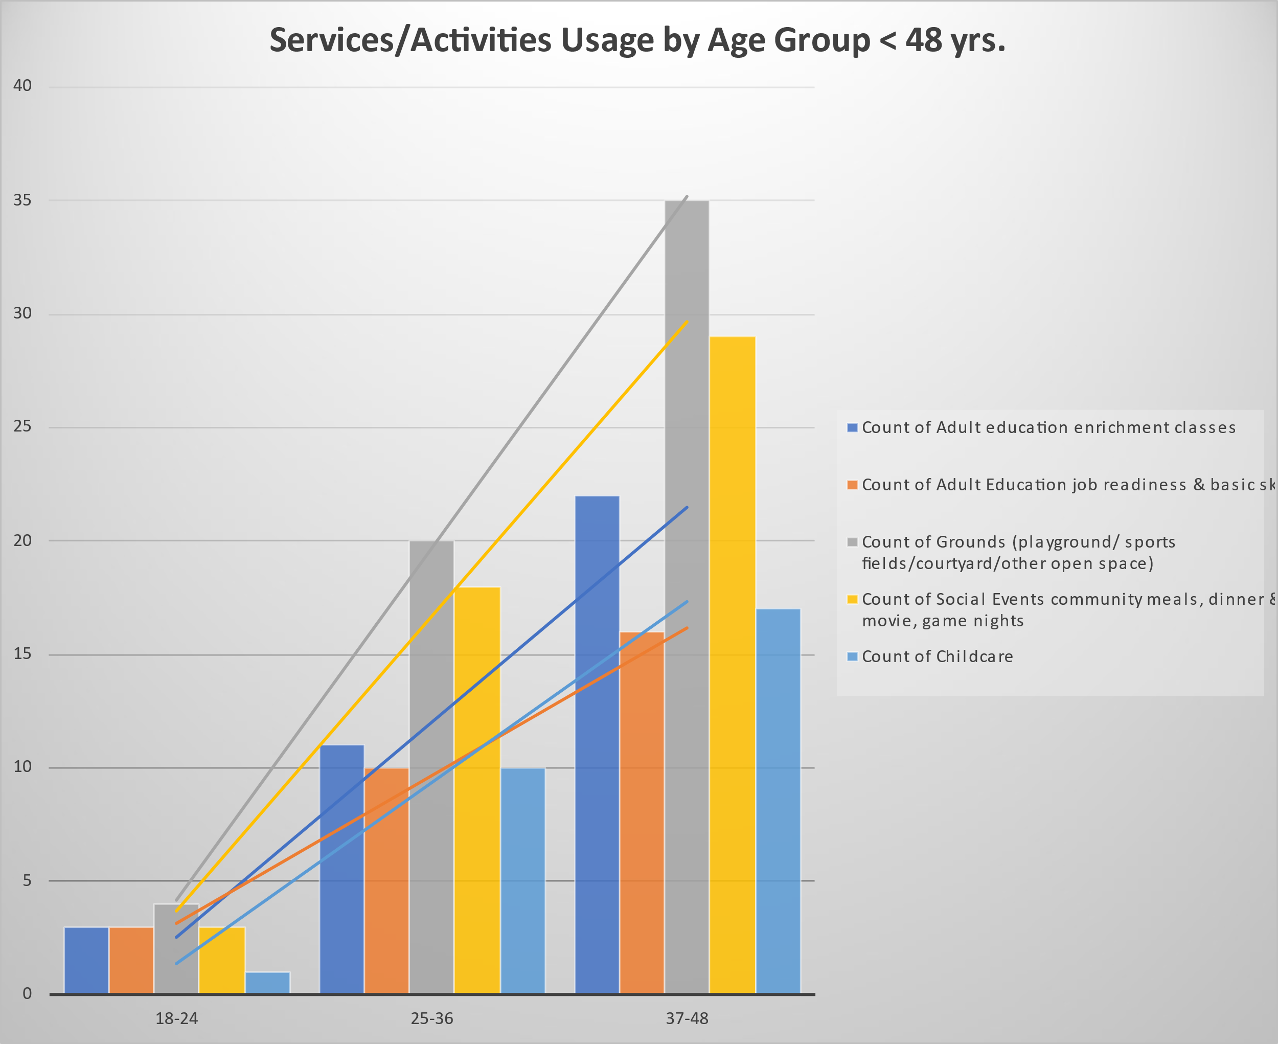
Services and Activities By Age
< 48 Years Old
Several items showed increasing interest as age groups increased:
  Adult education
  Child-care related
  Grounds
  Social Events
  Coworking Space
Younger families want things to do together and to improve their own skills

Slide 8
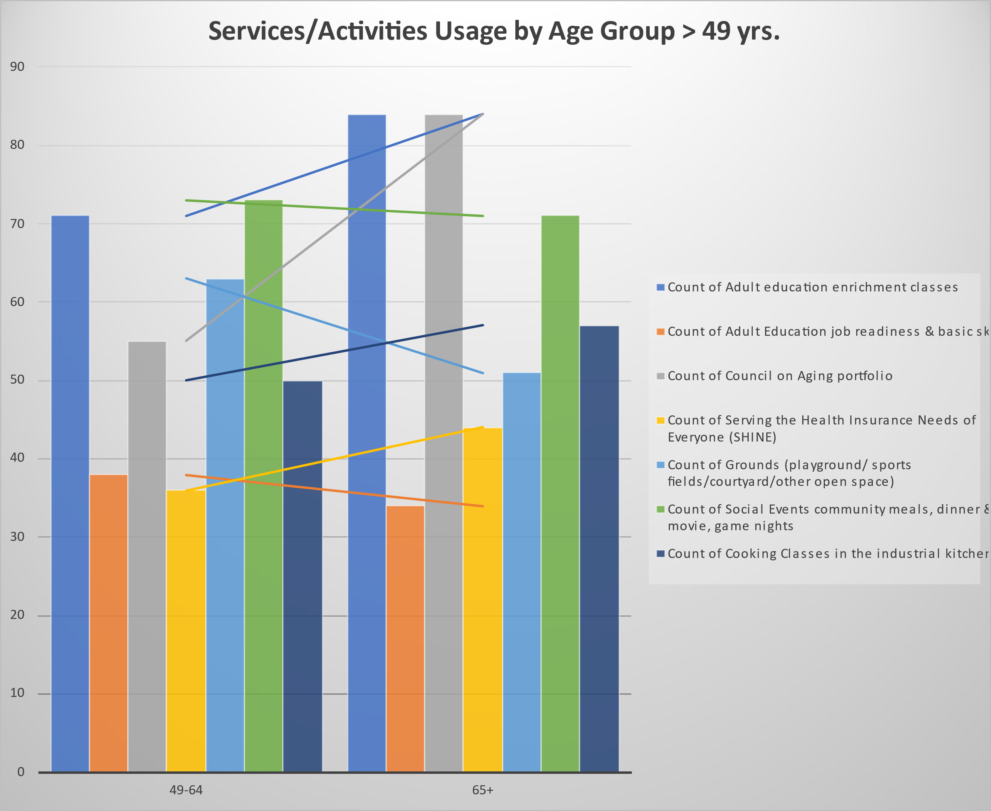
Services and Activities By Age
> 49 Years Old
CoA portfolio interest surged
Adult Education interest increased
Interest in Grounds and Social Events decreased
Wareham Seniors want a robust CoA program with rewarding ways to spend their time

Slide 9
Households With Children
Grounds, Social Events, After-School Care, and Adult Ed are the most popular services
Wareham families want to learn, work, and play at a Decas Community Center

Slide 10
Households With Elders
Adult Ed, Council on Aging, SHINE, VA Services are the most popular services
Wareham Seniors want access to activities that are rewarding and help them thrive

Slide 11
Notional Household
Using 2020 Census Data, a typical Wareham household is constructed
  2.3 household size with children
  $55,000 to $75,000 income
Filtering the responses to match these characteristics reveal that the interests would closely match the Households with Children responses

Slide 12
Social Needs of Wareham
Reponses are almost evenly divided on having sufficient childcare available
Respondents report difficulty accessing social services and getting transportation
Some families report food, housing, or utility insecurity

Slide 13
Insufficient Childcare
Adult Ed, Social Events, and Grounds are again the most wanted services
Wareham families want to learn new things and enjoy greenspaces with their families

Slide 14
Insufficient Eldercare
Adult Ed, Cooking Classes, Social Events, Grounds, and CoA Portfolio are the most wanted services
Wareham Seniors want a robust and accessible CoA and opportunities to learn/try new things

Slide 15
Serious Social Need
Serious Social Need is defined as having answered “Yes” to one of the insecurity questions
Adult Ed, After School Care, Social Events, Grounds, and Disability Services are the most wanted services
Wareham families in need want access to support structures and services

Slide 16
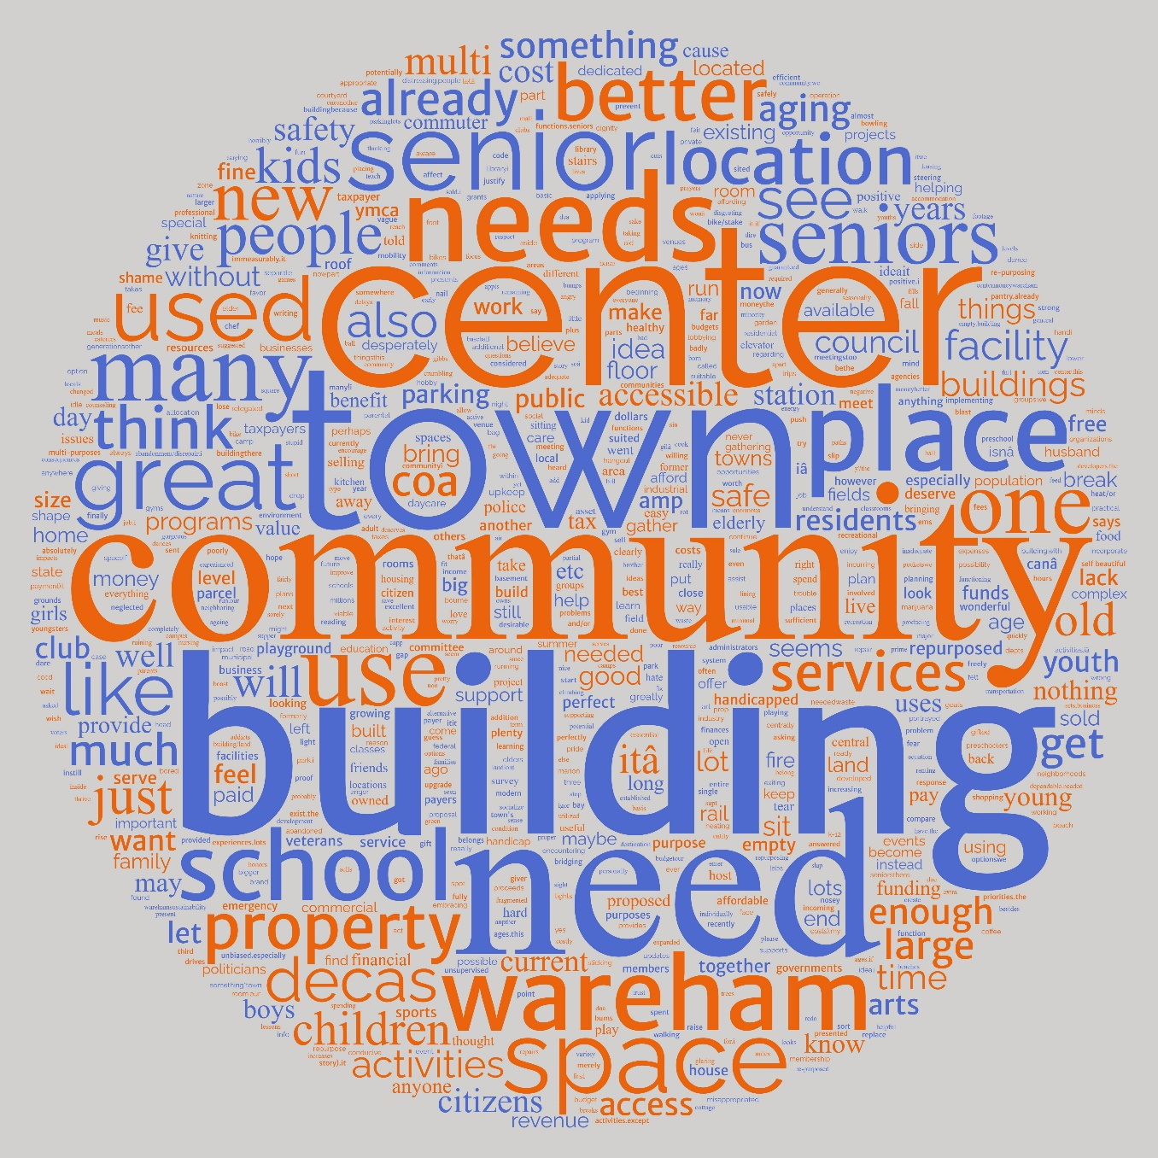
Word Cloud
“Why do you feel that way?”
Most common words:
  Center
  Town
  Community
  Building
  Need
  Senior

Slide 17
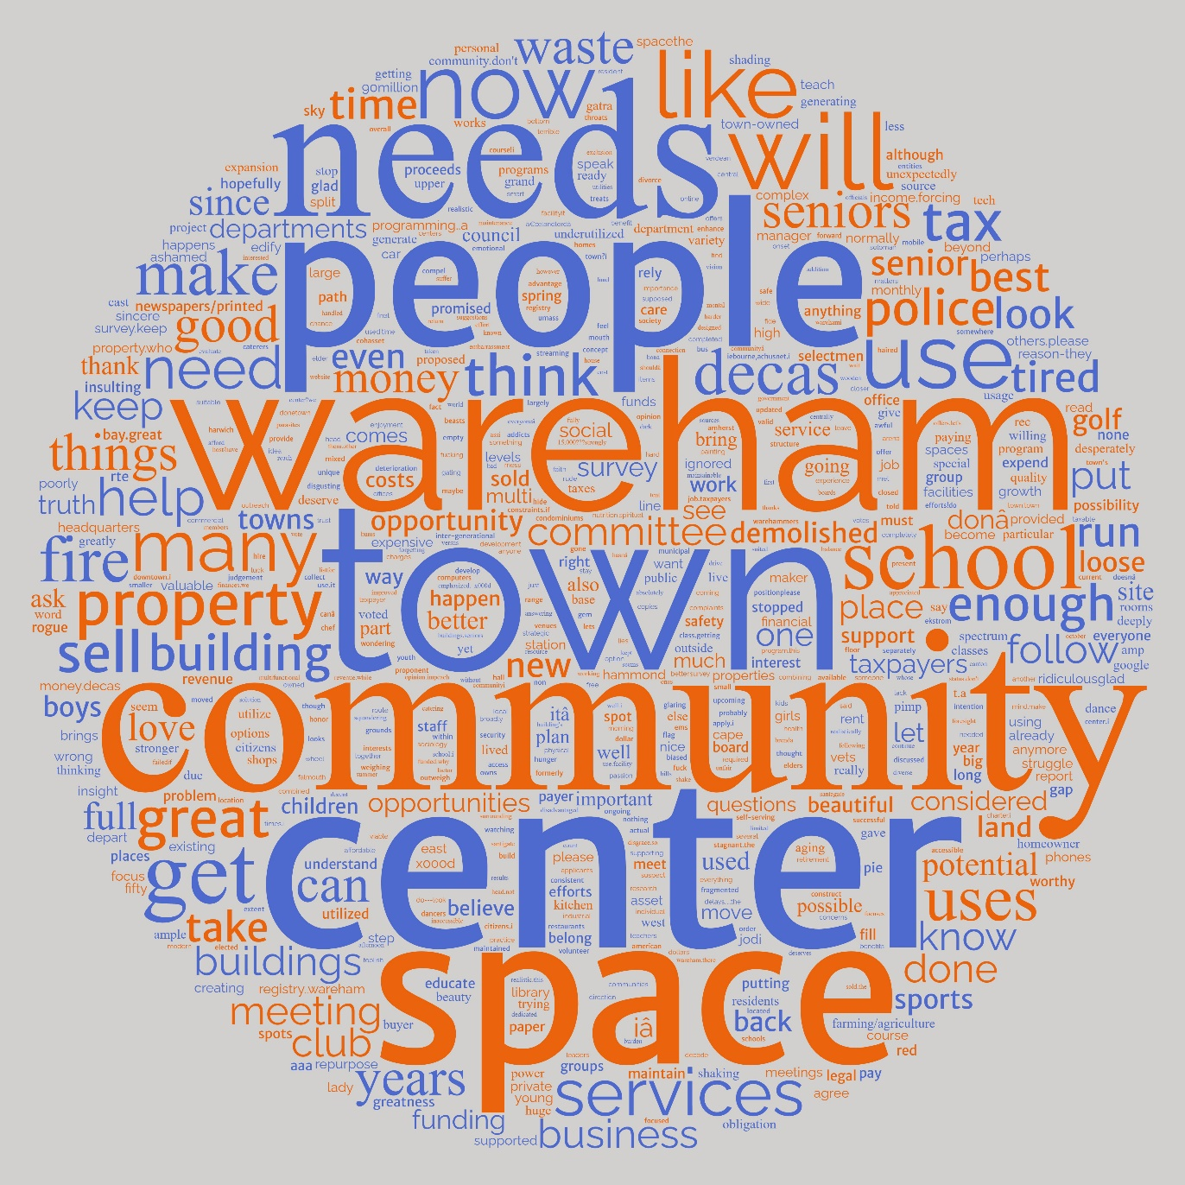
Word Cloud
“Final Comments”
Most common words:
  People
  Needs
  Wareham
  Town
  Community
  Center
  Space

Slide 18
Key Findings
Adult Education is a common want for the town regardless of age
CoA Portfolio is by far the most wanted service for senior respondents
As Wareham Families age and grow, services related to leisure with children (grounds, social events) become more important
As Wareham seniors age, strong support services and activities become more important
Wareham residents want a robust and varied multi-generational community center regardless of how it is funded

Slide 19
Limitations of data
Sample Size is around the size of Town Meetings (~1.5% of Wareham Population of 23,000)
Responses skew older, female, and upper income
Some respondents did not feel comfortable sharing all the requested information (and that’s ok!)

