Slide 1
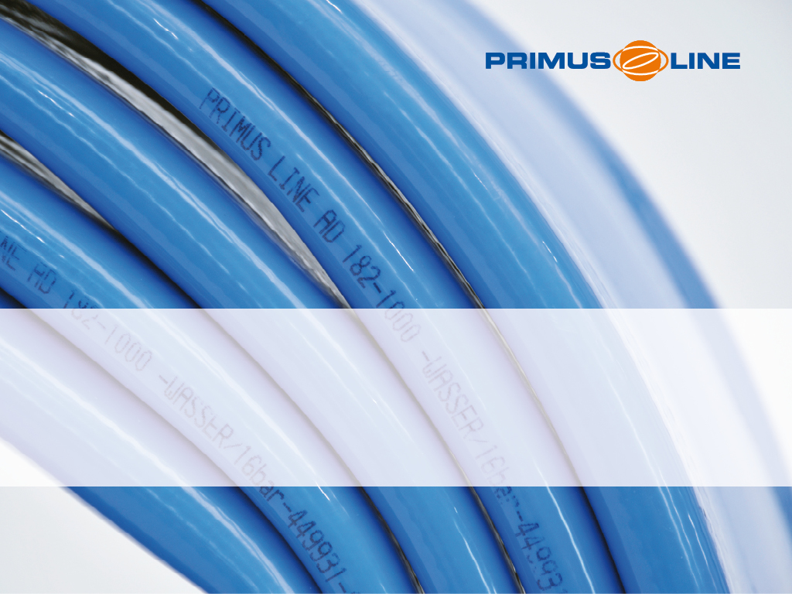
Narrows pump station SRM rehabilitation
Wareham MA

Slide 2
Project overview
Sewer rising main located along Sandwich Rd,Narrow Rd and Minot Avenue in Wareham MA
Transports sewage water from Narrows pump station to Wareham Water Pollution Control Facility (WPCF)
Total Liner length approx 9,152 LF
Ductile iron pipe 16“ x 18“
16“ pipe 3,047 LF, 18“ pipe 6,105 LF
Several tie-ins, ARVs and 45 degree bends
The project has 13 pits and 7 pulls
The highest point of the pipe is at pit 10 (Air release valve)
Needed to install a gooseneck or Candycane at the end of the pipe

Slide 3
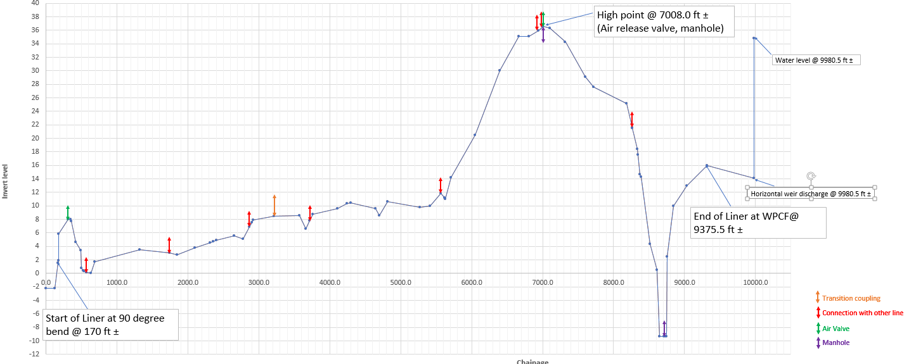
Longitudinal section

Slide 4
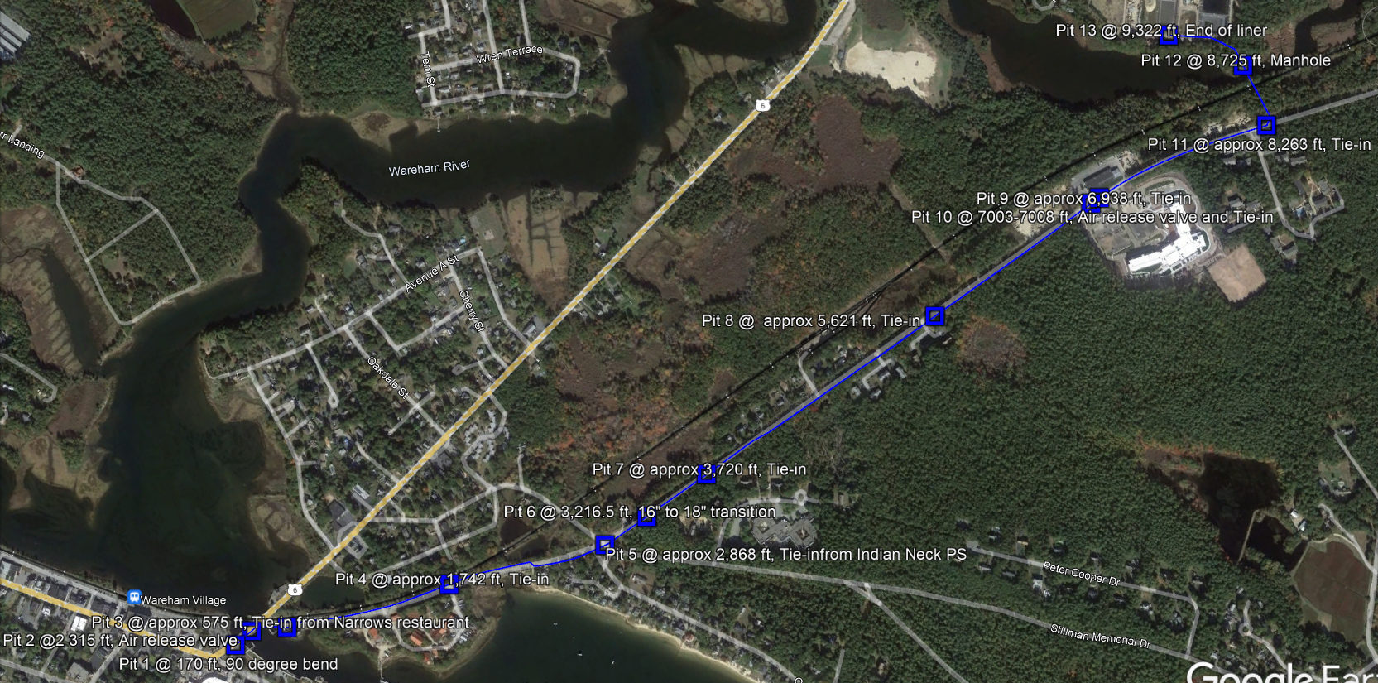
Ground view

Slide 5
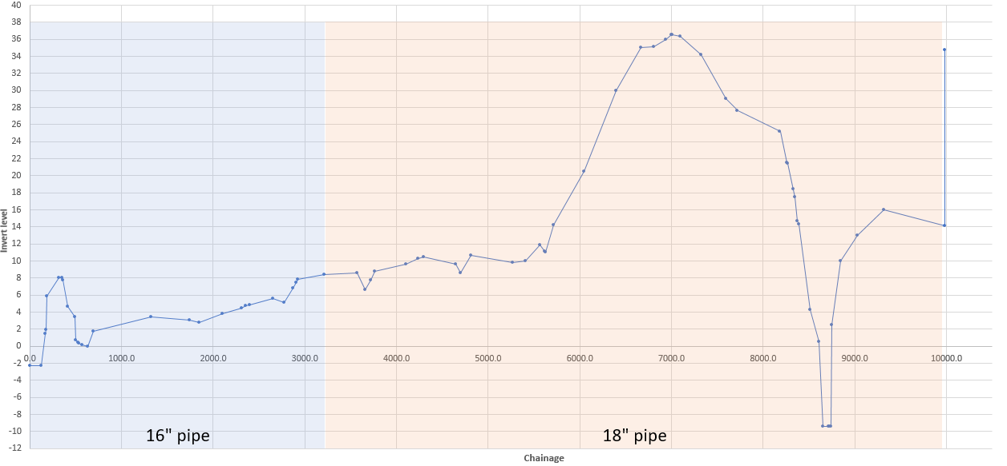
Pipe sections
The pipe starts as a 16“ pipe, at station 32+16.5 there is a transition to an 18“ pipe

Slide 6
Planned Pits
The project has 13 pits in total, the list of pits is as follows:
Pit 1, sta 1+70, 90 degree bend
Pit 2 sta approx. 3+15, air release valve
Pit 3 sta approx. 5+75, tie-in from Narrows restaurant
Pit 4 sta approx. 17+42, tie-in
Pit 5 sta approx. 28+68, tie-in from Indian Neck PS
Pit 6 sta 32+16.5, 16“ to 18“ transition
Pit 7 sta approx. 37+20, tie-in
Pit 8 sta approx. 56+21, tie-in
Pit 9 sta approx. 69+38, tie-in
Pit 10 sta approx 70+03 to 70+08, air release valve, tie-in
Pit 11 sta approx 83+63, tie-in
Pit 12 sta 87+25, manhole
Pit 13 sta 93+22, end of liner

Slide 7
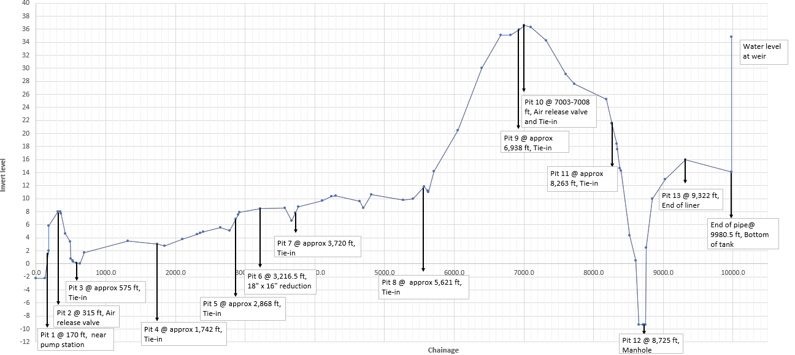
Planned pits

Slide 8
Planned pulls and phases
The project was planned to be done with 7 pulls divided in 3 phases:
Phase 1
Between pit 8 and pit 13
Pull 1 from Pit 10 to Pit 8, 1,382.0 LF
Pull 2 from Pit 10 to pit 12, 1,717.0 LF
Pull 3 from Pit 13 to pit 12, 597.0 LF
Phase 2
Between pit 4 and pit 8
Pull 4 from Pit 6 to Pit 8, 2,404.5 LF
Pull 5 from Pit 6 to pit 4, 1,474.5 LF
Phase 3
Between pit 1 and pit 4
Pull 6 from Pit 3 to Pit 1, 405.0 LF
Pull 7 from Pit 3 to pit 4, 1,167.0 LF

Slide 9
Planned pulls and phases
The calculated pulling forces are the following:
Stage | Pull | Launching pit | Receving pit | Length [ft] | Comments | Pulling force [ton] | Pulling Force [lbs]
1 | 1 | Pit 10, Air release valve @ (7,003 ft) | Pit 8, Tie-in (5,621 ft) | 1,382.00 | 2 x 5 vert bends | 2.24 | 4,941.91
 | 2 | Pit 10, Air release valve @ (7,008 ft) | Pit 12, Blowdown manhole (8,725 ft) | 1,717.00 | 2 x 11° vert bend 1 x 15° hor bend 2 x 45° hor bend | 3.73 | 8,223.14
 | 3 | Pit 13, End of Liner @ (9,322 ft) | Pit 12, Blowdown manhole (8,725 ft) | 597.00 | 1 x 22.5° hor bend 1 x 45° hor bend 2 x 45° vert bends | 2.50 | 5,515.29
2 | 4 | Pit 6, 18"x16" reduction @ (3,216.5 ft) | Pit 8, Tie-in (5,621 ft) | 2,404.50 | 1 x 5° hor bend 1 x 7° hor bend | 3.68 | 8,103.99
 | 5 | Pit 6, 18"x16" reduction @ (3,216.5 ft) | Pit 4, Tie-in (1,742 ft) | 1,474.50 | 2 x 45° hor bend | 2.86 | 6,300.30
3 | 6 | Pit 3, Tie-in @ (575 ft) | Pit 4, Tie-in (1,742 ft) | 1,167.00 | 2 x 45° hor bend | 2.49 | 5,494.44
 | 7 | Pit 3, Tie-in @ (575 ft) | Pit 1, Start of liner (170 ft) | 405.00 | 2 x 25° vert bend 2 x 34° vert bends 1 x 38° vert bend 2 x 45° vert bend | 2.85 | 6,291.84
 |  |  | Total | 9,147

Slide 10
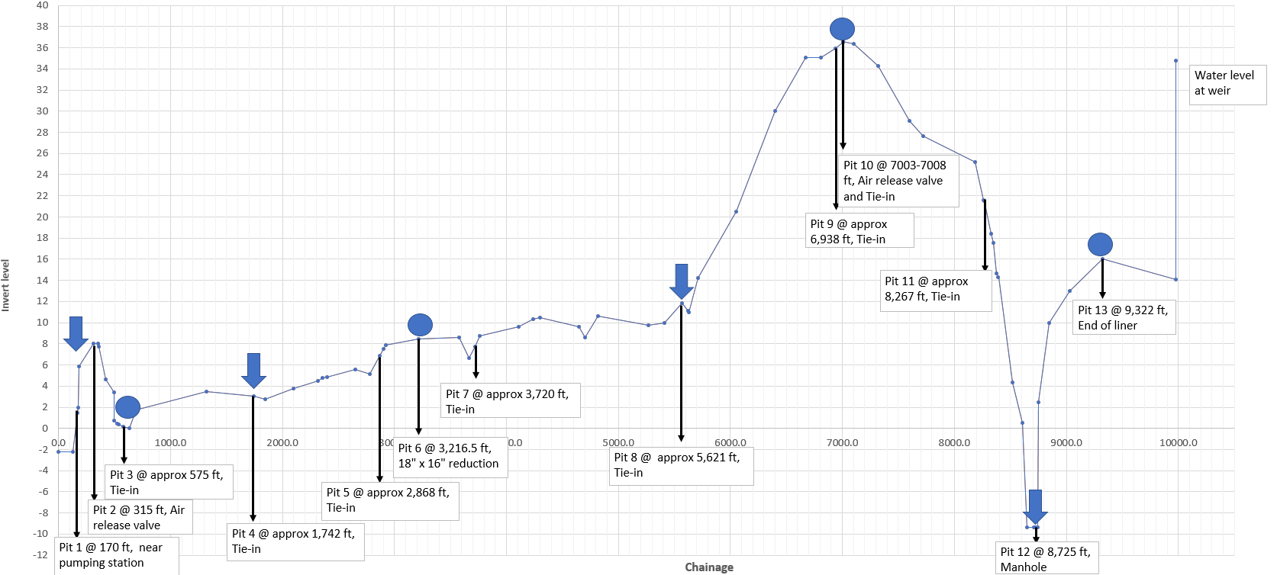
Excecution phases
Phase 3
Phase 2
Phase 1
Circles are where reels must be placed for each pull
Arrows are where winch should be placed for each pull

Slide 11
Liner reels
The liner was shipped as three T-600 reels (6m)
Reel 1 with 3,207.00 LF of 18“ liner
Reel 2 with 3,083.00 Lf of 18“ liner
Reel 3 with 3,182.00 LF 16“ liner
Reel 1 must be used to line the section between pit 8 and pit 12
Reel 2 must be used to line the section between pit 6 to pit 8 and the section between pit 12 and pit 13
Reel 3 must be used to line the section between pit 1 and pit 6

Slide 12
Liner Drums
Reel 3
Reel 2
Reel 1
Reel 2

Slide 13
Goosseneck/candycane
In order to ensure a proper operation of the Primus Liner a gooseneck has to be installed at the end of the pipe
Primus Line recommend to install a 2“ air release valve at the top of the gooseneck to avoid vacuum and to reduce noice
The gooseneck has to have insulation for cold waether to avoid freezing
The purpose of this gooseneck is to create a new high point for the pipe

Slide 14
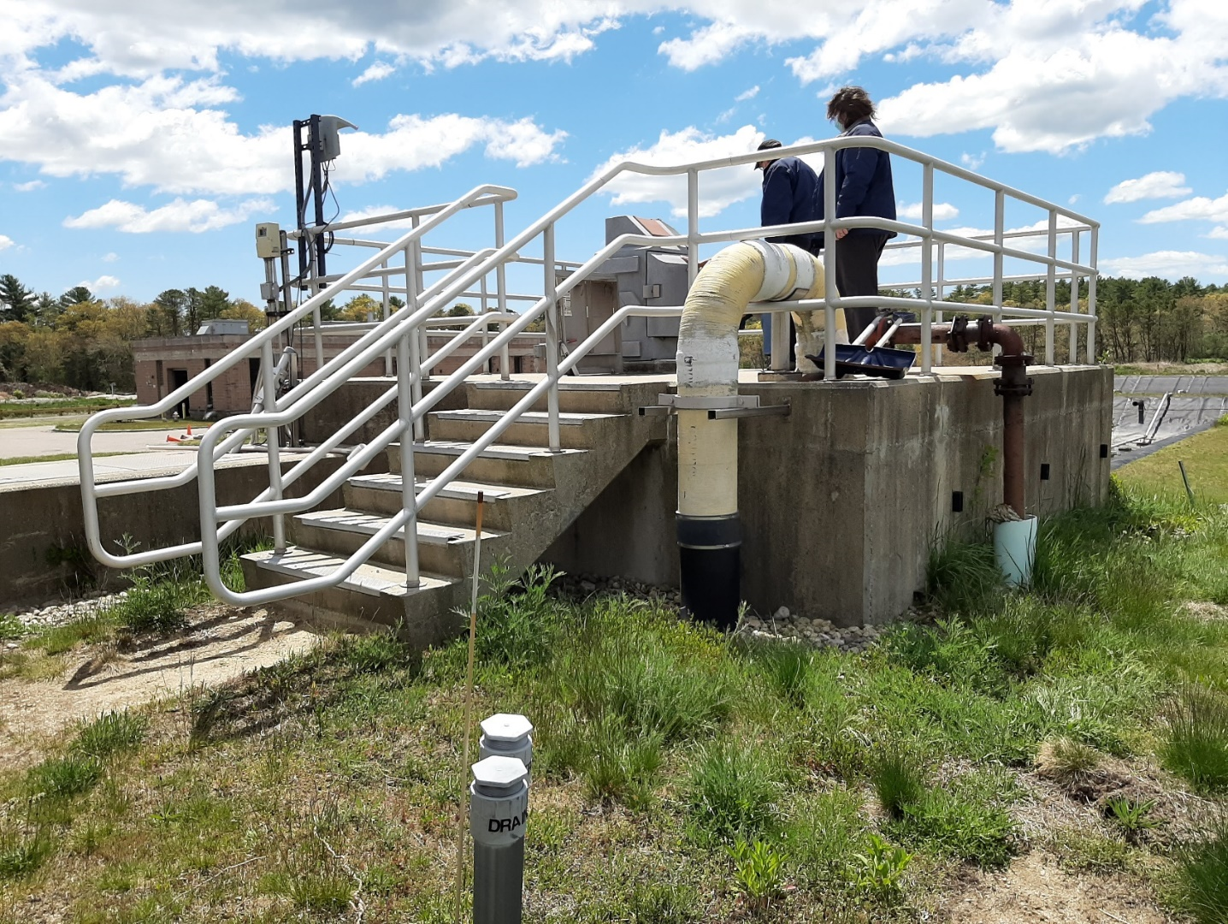
Goosseneck/candycane
The gooseneck has to be installed at the end of the 18“ pipe at the bottom of the chamber shown above

Slide 15
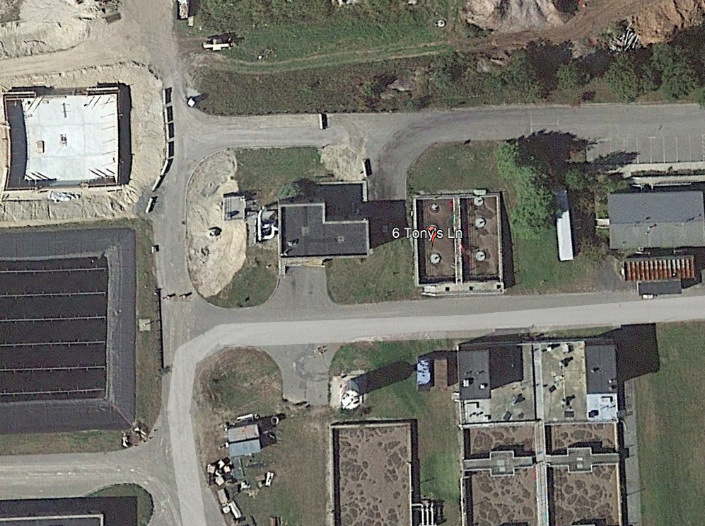
Goosseneck/candycane
The gooseneck has to be installed at the end of the 18“ pipe at the bottom of the chamber shown above

Slide 16
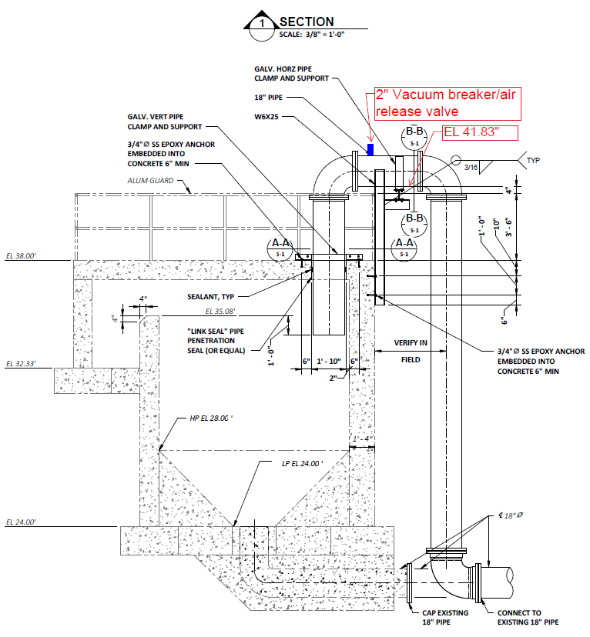
Goosseneck/candycane

Slide 17
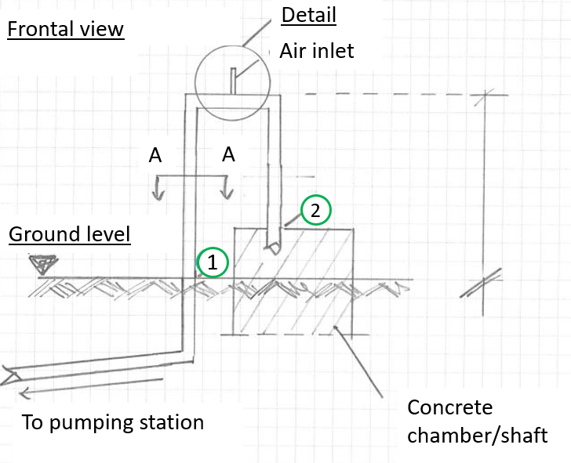
Goosseneck/candycane
We recommended to “cover” the entire goose neck between position 1 and position 2 (see image).
The goose neck is protected from freezing with the cover, which also provides sound insulation.

Slide 18
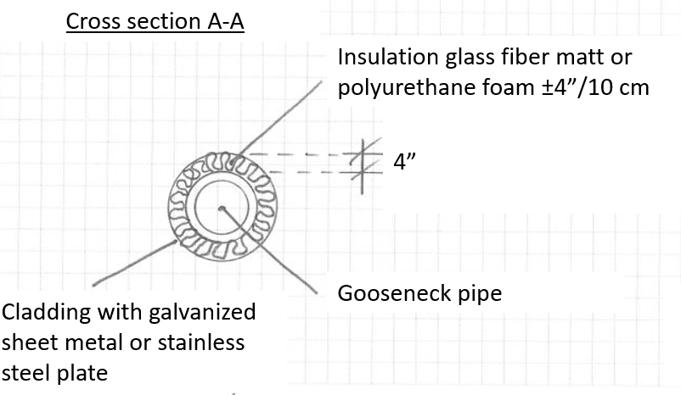
Goosseneck/candycane
We recommended to “cover” the entire goose neck between position 1 and position 2 (see page image).
The goose neck is protected from freezing with the cover, which also provides sound insulation.

Slide 19
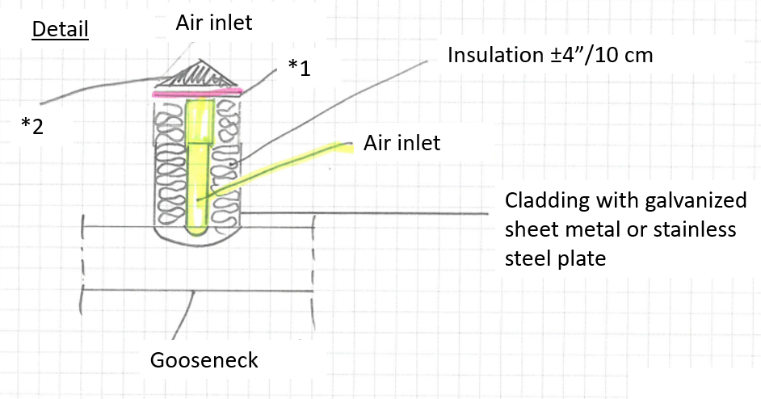
Goosseneck/candycane
*1 grid/ protection from insects and animals
*2 roof or weather protection

