Slide 1
Stormwater Ponding at the Friary
Proposed Maritime Haven

Slide 2
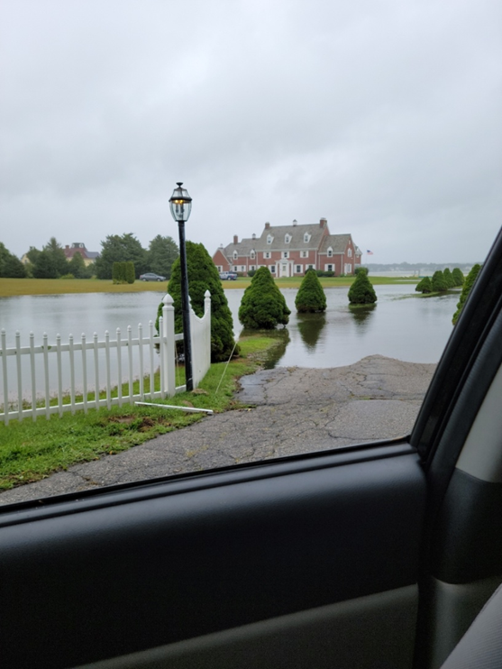
From Robinwood Rd., at Main Entrance Gate

Slide 3
From the Botelho home at 52 Robinwood Rd., SW border of Friary property, looking NW behind the garage/gatehouse and across entrance roadway.

Slide 4
From the Botelho home at 52 Robinwood Rd., South border of Friary property. Looking at Friary building.

Slide 5
Photo Locations

